Slide 1
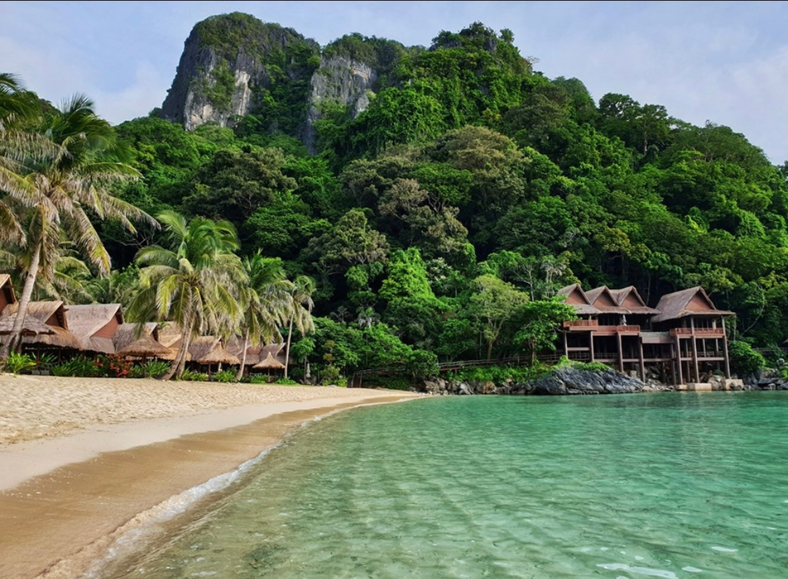

The React Retreat
A MERN Stack Project

Slide 2
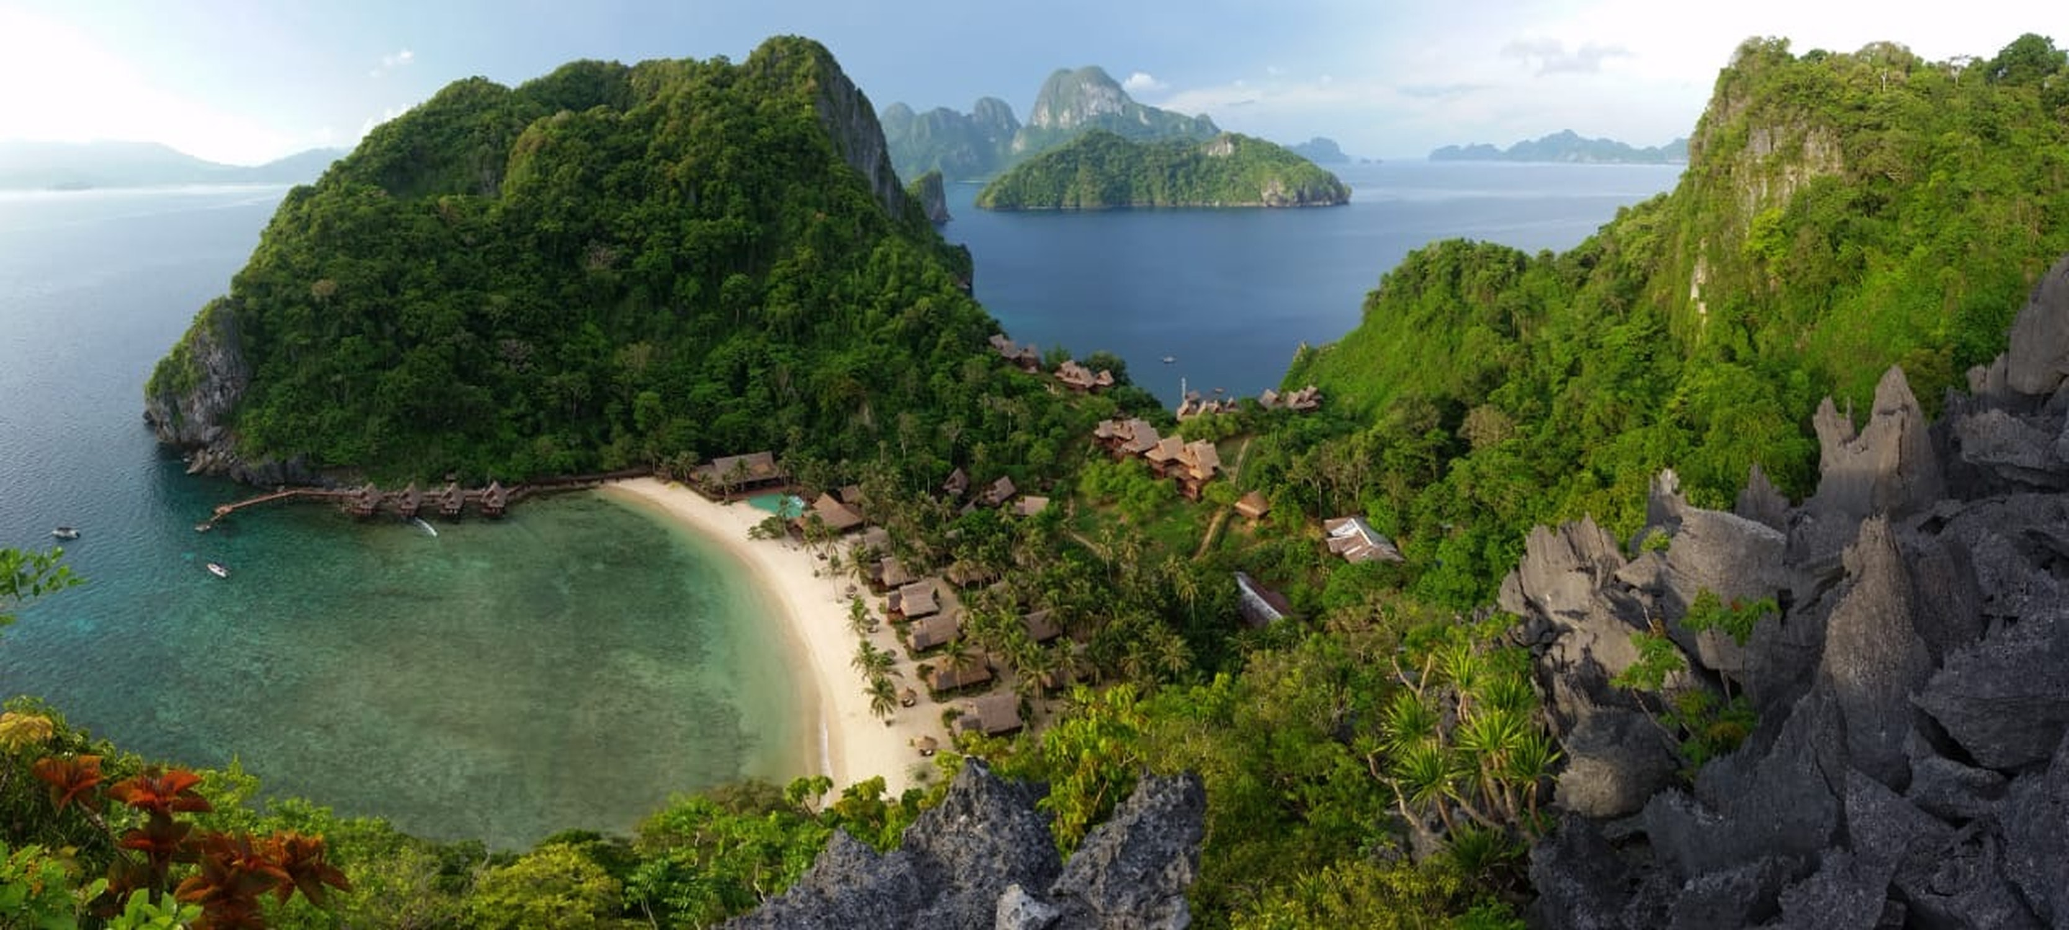
Elevator Pitch
The goal of our team was to create one of these websites for our class.
The React Retreat is a (fictional) luxury hotel that wants to be able to advertise to guests and allow them to make reservations using their website
Hotels need engaging and functional websites to attract potential guests and entice them to make a reservation and come to stay.
These websites must be both beautiful and easy to use.

Slide 3
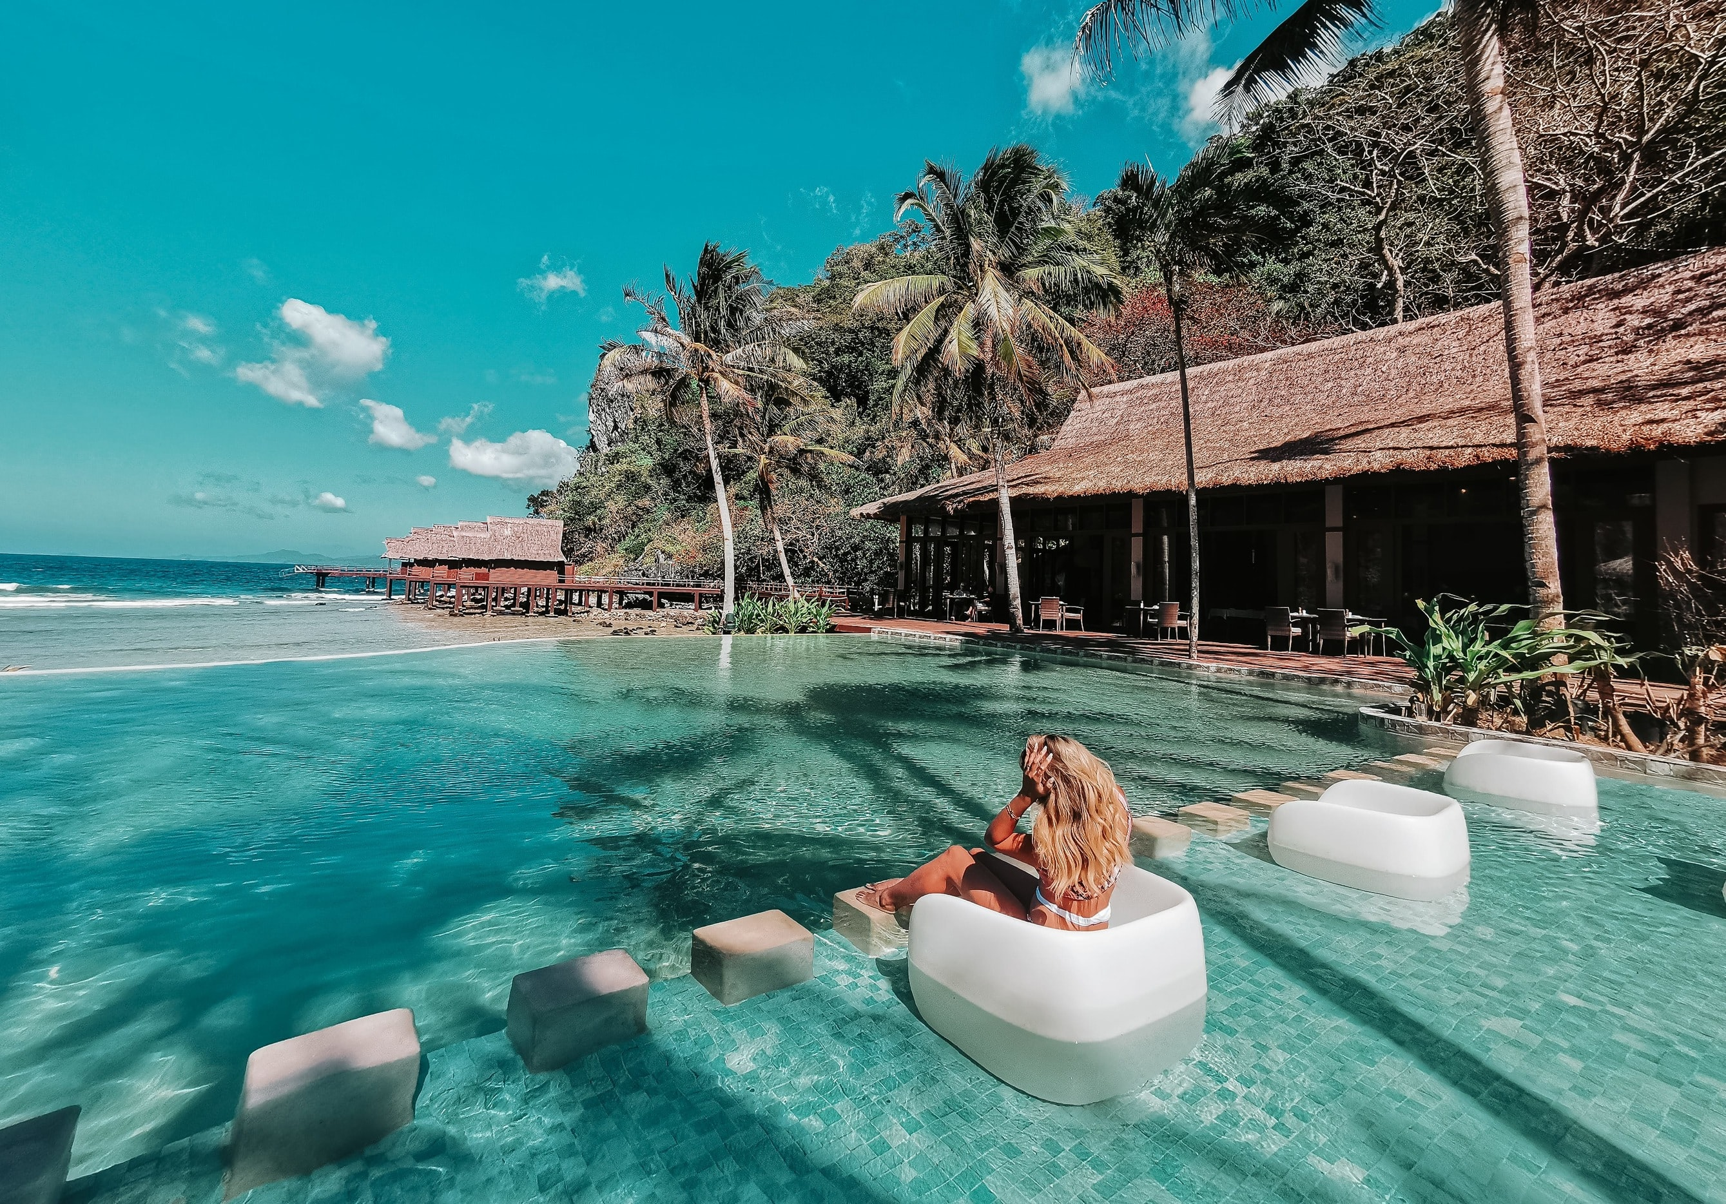
Concept : The Hotel Website of your dreams
As a person looking for a vacation spot:
When I visit a hotel website, I want to see pictures depicting the resort and rooms available
When I click on a room, I want to see more details, and be presented with an option to make a reservation
When I chose to make a reservation, I am prompted to log in, or create an account
When I click on my Booking History, I can see all my confirmed reservations
When I click on the Contact page, I can choose to contact the hotel staff.
As a hotel administrator:
I want to be able to view all the bookings and registered guests.

Slide 4
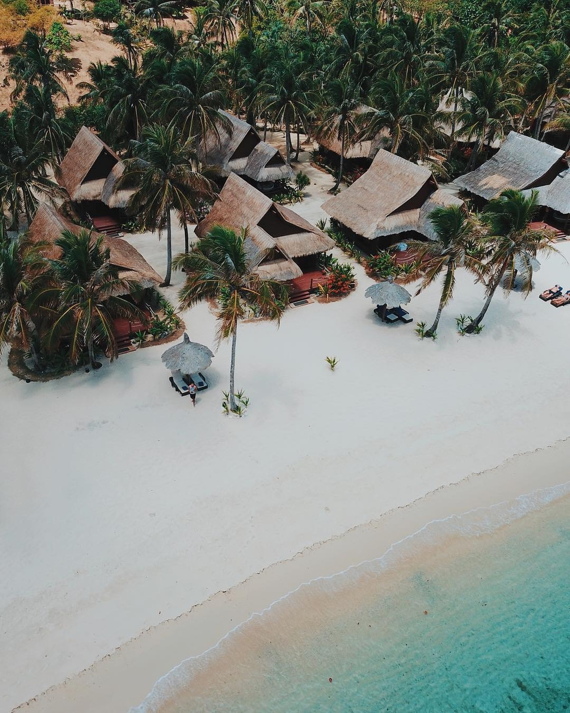
Process
Technologies used
MERN stack, Mongoose, GraphQL, Redux, JWT authentication, reactstrap, CSS, JavaScript, photo carousel library, Create-React-App service worker.
Breakdown of tasks and roles:
Kathleen: Express server and Mongo database, models, typeDefs, resolvers, seeding, queries and reducers for booking history and admin pages, Booking History and Admin pages, Footer component, service worker setup.
Damaris: Authentication set up, Navigation component with conditional rendering, Contact page, image research and selection.
Michael: Front end components and pages for hotel rooms, room categories, and bookings; queries and reducers for reservations and checkout; Reservation page and form.
Cristian: Front end styling and photo carousels

Slide 5
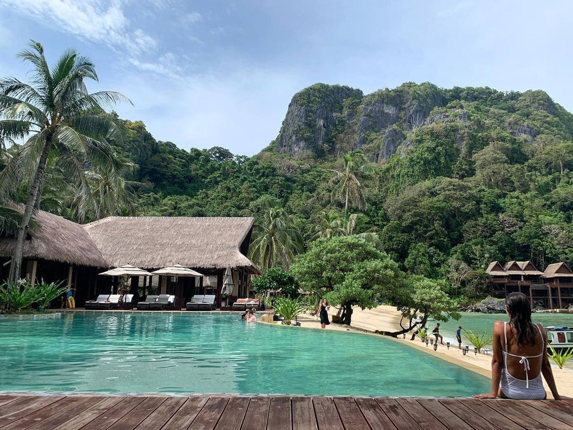
Process
Challenges:
Creating the database structure such that the Bookings, Rooms, and Users all properly referenced each other and populated correctly in queries.
Creating the reservation object from the web page in the correct form with all necessary information.
Successes:
Photo carousels for the hotel and rooms.
Conditional rendering for administrative and guest users.
Creating the database and seeding with multi-relational data.
The reservation system working and populating a user’s booking history

Slide 6
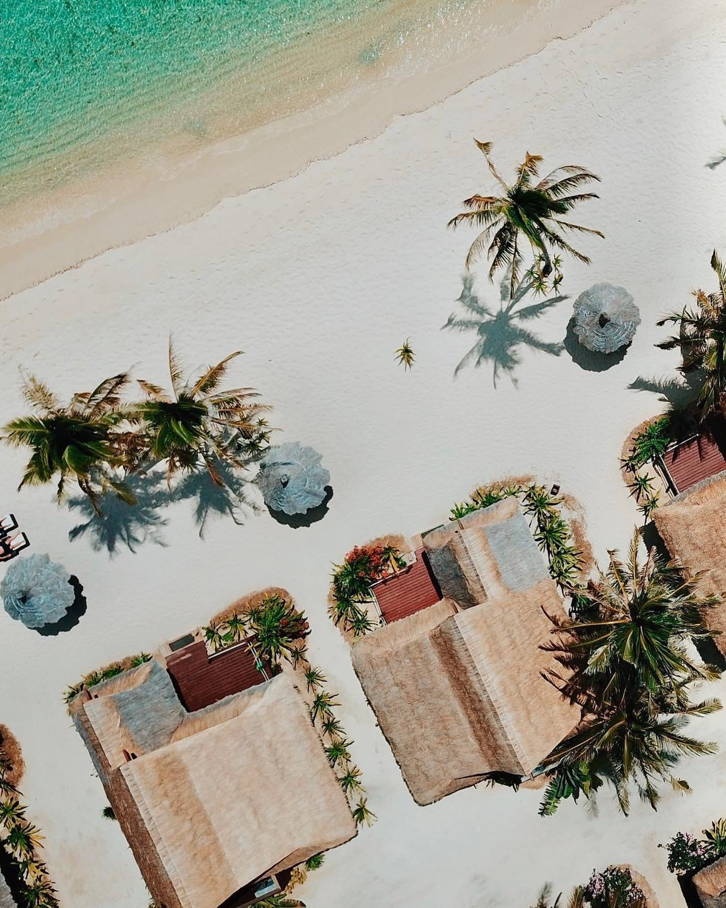
Demo

Slide 7
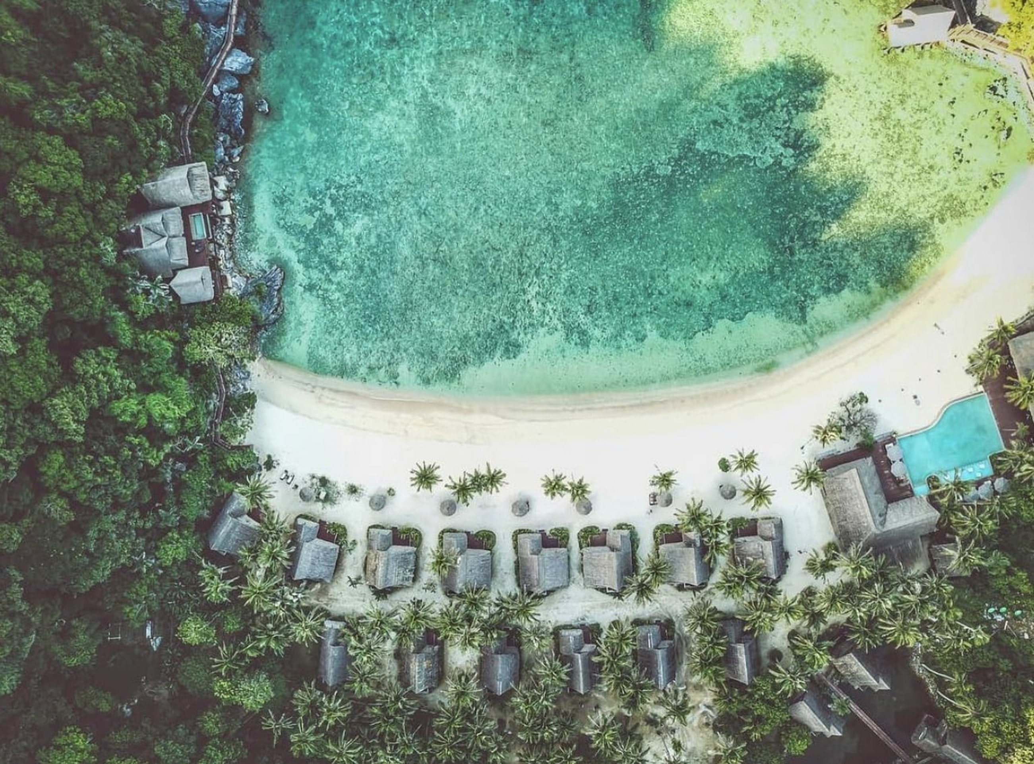
Directions for Future Development
Show unavailable dates for a given room on the reservation date picker.
Functionality for admin page to view and modify individual bookings that are in the future (e.g., upgrade a room, change check-out date, etc.).
Allow multiple room types in a single booking.
Functionality for guest accounts to update email and change password.
Functionality for guest accounts to update or cancel future bookings.
ADA compliant room category.
Extras for the room like a crib or a celebration basket.
After check-in options like ordering room service.
Page for in progress Reservations

Slide 8
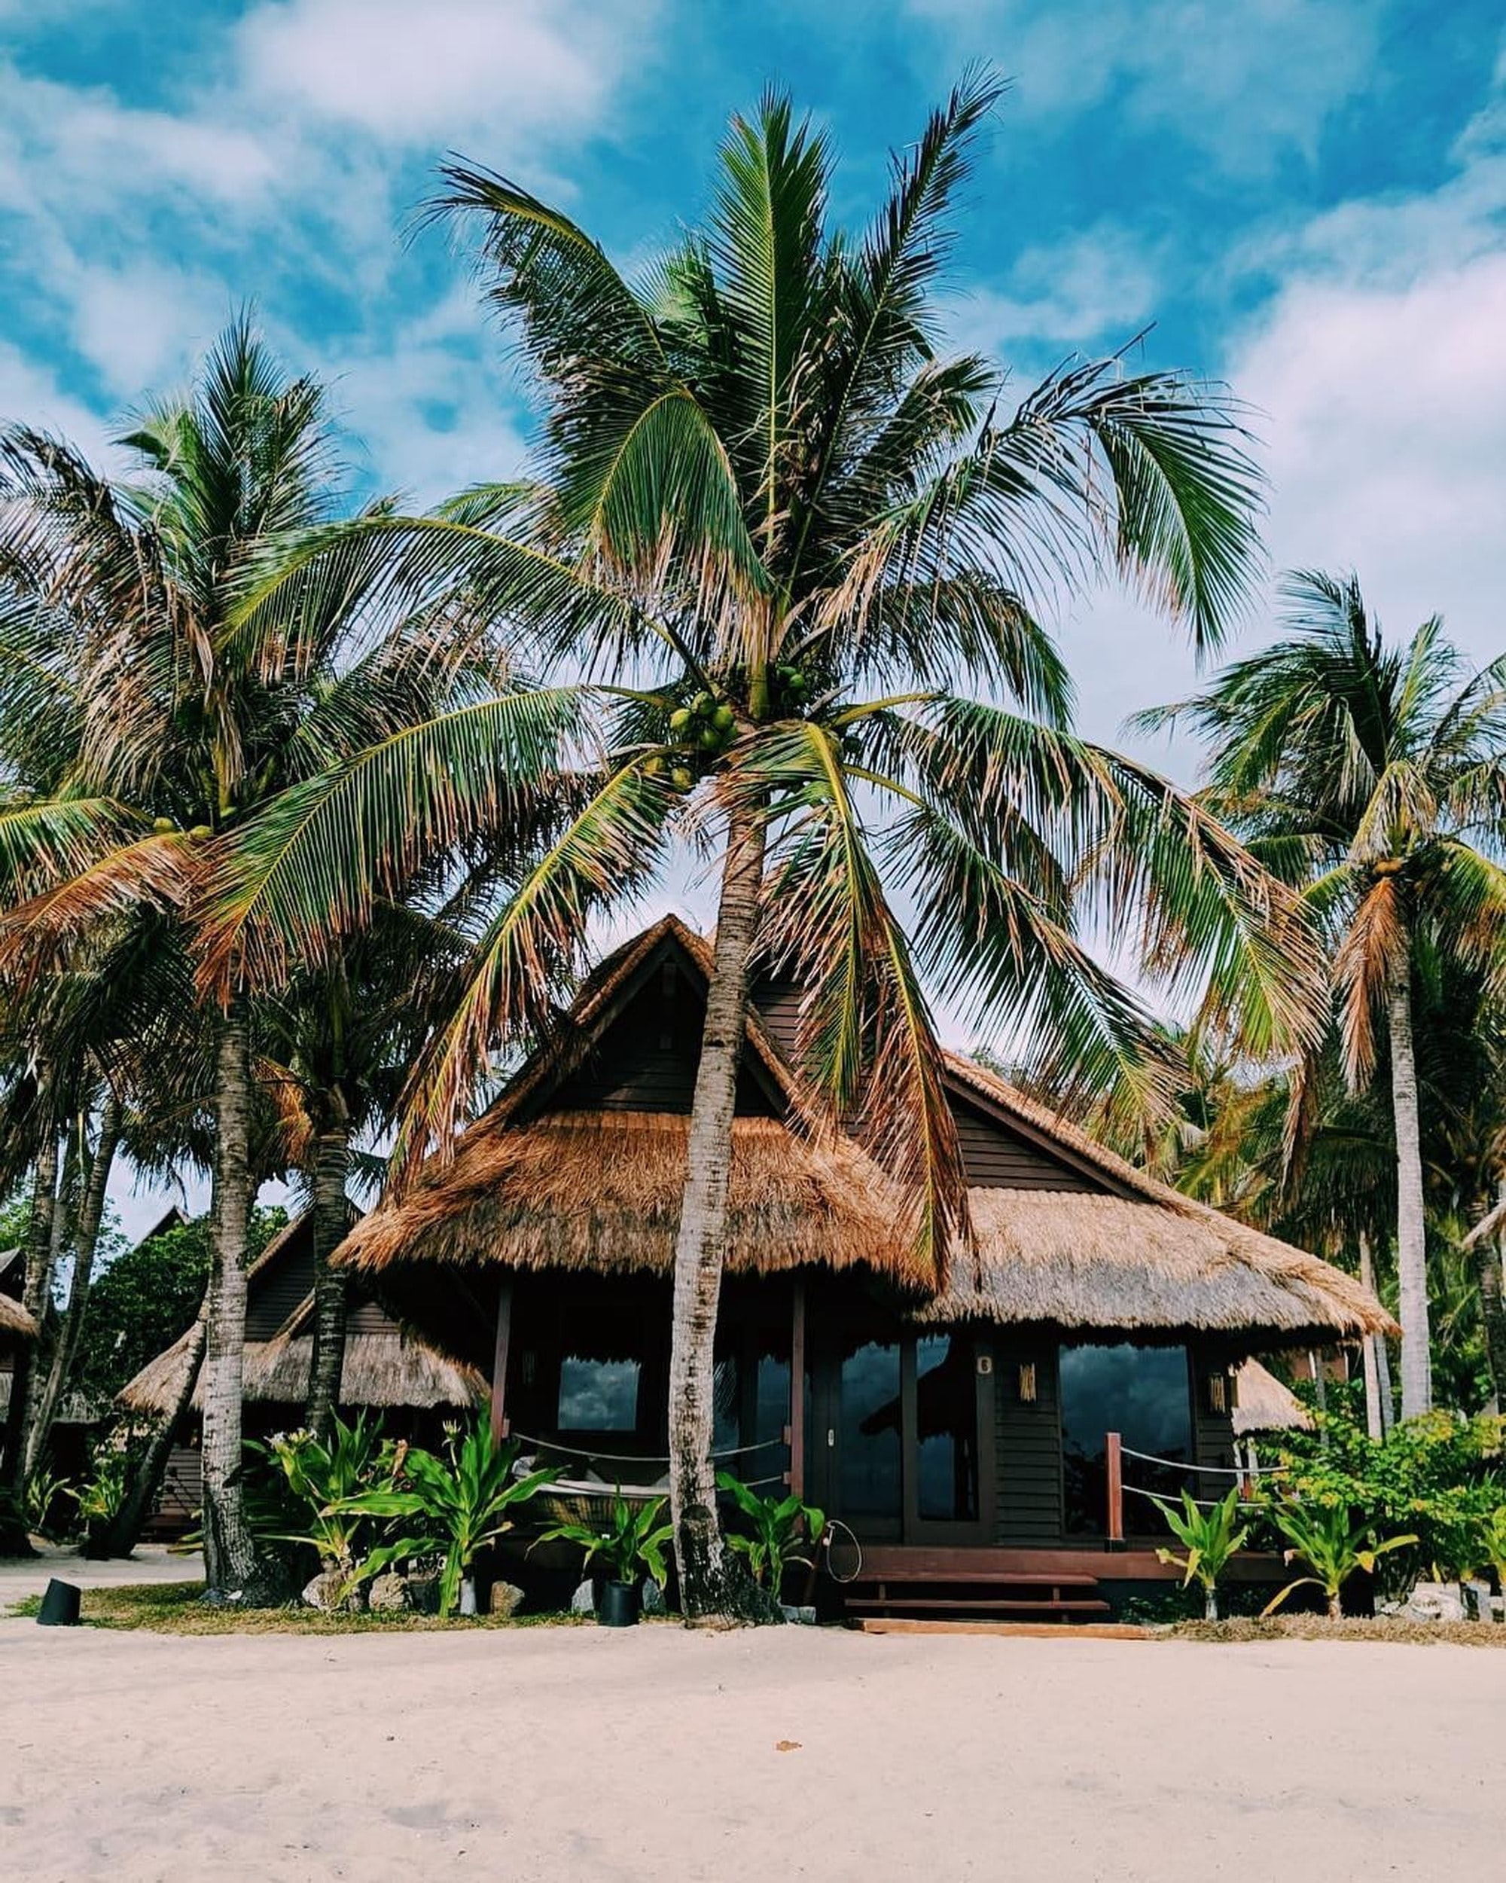
Links
Deployed: https://react-retreat.herokuapp.com/
GitHub repo: https://github.com/kpehl/react-retreat

